Slide 1
Reviewing Super Hero U Ad Campaigns
SUBGROUP 2

Slide 2
OUR TEAM
Muhammad Ahmed (mahmed2952019@gmail.com)
Pratham Mehta (prathammehta6999@gmail.com)
AbdulKarim Ali (abdularimsali99@gmail.com)
Lalith Kumar Gali (lgali@hawk.iit.edu)
rishit jhaveri rishitjhaveri02@gmail.com
Harshitha Reddy Talusani (harshitha.reddy3599@gmail.com)
Sai Kiran Kalyankar (kalyankarsai@gmail.com)
Ankit Poudel (poudelankit66@gmail.com)
Nusrat Sultana (nusratlira8@gmail.com)
Ramesh Chandra Reddy ( rmusilanna@hawk.iit.edu)
Shilpashree Gangadhara (sgangadhara@hawk.iit.edu)
Vaishnavi Kundeshwara Bhat(vaishnavivkb@gmail.com)

Slide 3
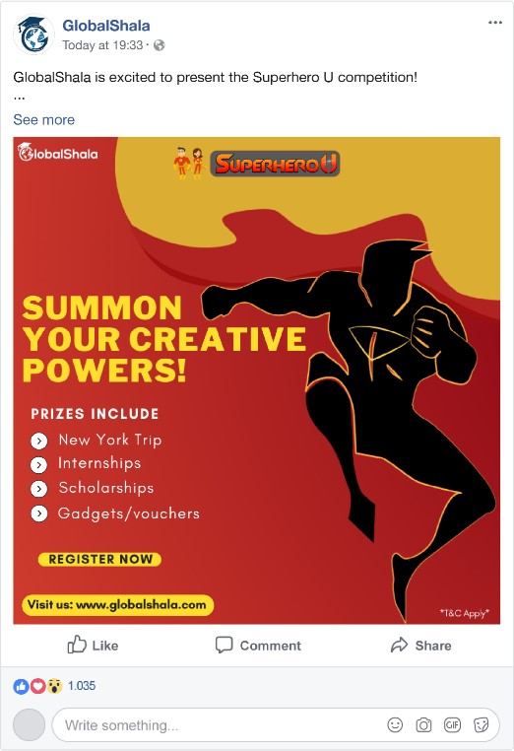
FACEBOOK ADS
Basic Image Ad also known as ‘Link Click Ad’.
Audience targeted : ‘Interns’ , ‘Educators and Principals’
Each click generates money.
11 campaigns were held.

Slide 4


SUPER HERO U EVENT
This event is to attract customers to register themselves at Global Shala.
“Summon Your Creative Powers” is the event name.
Prizes Include: New York Trip, Internships, Scholarships and Gadgets & Vouchers

Slide 5
Overview of the Campaign
Campaign 1
Group 1 (Australia, Canada, United Kingdom, Ghana, Nigeria, Pakistan, United States)
Highest Campaign Cost
Age group: 25-64
Campaign 2
Group 2 (Australia, Canada, United Kingdom, Ghana, Niger, Nigeria, Nepal, Pakistan, Thailand, Taiwan)
Second Highest Campaign Cost
Age group: 13-34
Campaign 3
Australia
Average Campaign Cost
Age group: 13-34
Campaign 4
Canada
Average Campaign Cost
Age group: 13-34
Campaign 5
Ghana
Average Campaign Cost
Age group: 13-34
Campaign 6
India
Average Campaign Cost
Age group: 13-34
Campaign 7
Nepal
Third Highest Campaign Cost
Age group: 13-34
Campaign 8
Nigeria
Average Campaign Cost
Age group: 13-34
Campaign 9
UAE
Average Campaign Cost
Age group: 13-34
Campaign 10
UK
Average Campaign Cost
Age group: 13-34
Campaign 11
USA
Average Campaign Cost
Age group: 13-34

Slide 6
Why should this Campaign be discarded?
Rs. 2333.3
High Cost
25-64
Age group targeted is different than other ads
Reach and Impressions low
Countries targeted is same as Group 2 and Campaign 11 hence by discarding this campaign it wont affect.

Slide 7
CONCLUSION
Campaign 1 spent the highest cost, even though geography wise it targeted many countries, it doesn’t target the active age groups.
The reach and impressions are low compared to the expenses.
It doesn’t target the common age group as other campaigns thus we can say that this campaign doesn’t have much affect.
Campaign 2 and Campaign 11 together target the same countries as that of campaign thus discarding this campaign will not have much affect.
Hence according to my analysis, Campaign 1 should be stopped.

